Slide 1
Tempo Detection and Beat Marking for Perceptual Tempo Induction
Geoffroy Peeters
IRCAM – Sound Analysis/Synthesis
1, pl. Igor Stravinsky
75004 Paris – France
peeters@ircam.fr
Presenter: Mao-Yuan Kao
Date: Sept. 28, 2006

Slide 2
Abstract
We give a short overview of the tempo detection and beat marking algorithm
we have proposed for the MIREX 2005 perceptual tempo induction contest.

Slide 3
Algorithm
The system we propose in this paper is a tempo tracker system. It has been
designed in order to allow tracking of fast variations of tempo as well as
detection for music with and without percussion (classical music).

Slide 4
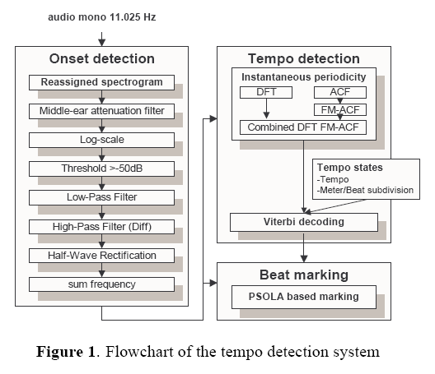
Algorithm (cont.)
The system relies on three stages: onset detection, tempo estimation, beat marking.

Slide 5
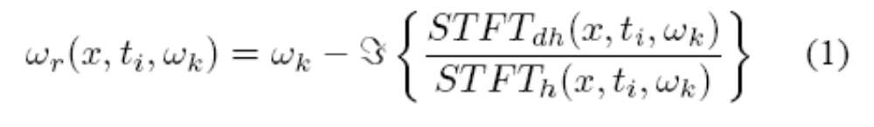
Onset-Energy Function
An onset-energy function is first computed using a proposed reassigned
spectral energy flux function.
The reassigned spectrogram consists in reallocating the energy of the “bins” of
the spectrogram (bin=frequency w_{k} of the STFT at time t_{i} of the frame)
to the frequency w_{r} and time t_{r} corresponding to their center of gravity.
The reassignment of the frequencies is based on the computation of the
instantaneous frequency (time derivative of the phase) and can be efficiently
computed by:

Slide 6


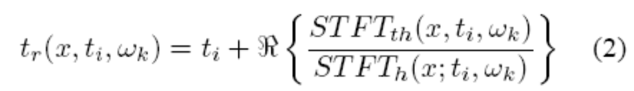

Reassigned Spectrogram
Where stands for the imaginary part, h stands for the analysis window and
dh stands for the time derivative of the window: .
The reassignment of the times is based on the computation of the group delay
(frequency derivative of the phase spectrum) and can be efficiently computed
by:
Where stands for the real part, h stands for the analysis window and th stands for the frequency derivative of the window (th = t · h(t)).
Each bin (w_{k}, t_{i}) of the spectrogram is then reassigned to its center of gravity (w_{r}, t_{r}) . The bins are accumulated in the time and frequency plane.

Slide 7
Reassigned Spectral Energy Flux

Slide 8

Reassigned Spectral Energy Flux (cont.)
The signal is first down-sampled to 11.025 Hz and converted to mono (mixing both channels).
The reassigned spectrogram X(w_{k}, t_{i}) is computed using a hamming window.
apply a filter which simulate the attenuation of the human middle ear
the energy spectrum is converted to the log scale in order to work on relative variations of energy.
apply a threshold of -50dB
low-pass filter then differentiate each frequency band energy
Half-Wave Rectification of each frequency band
summation over frequencies

Slide 9
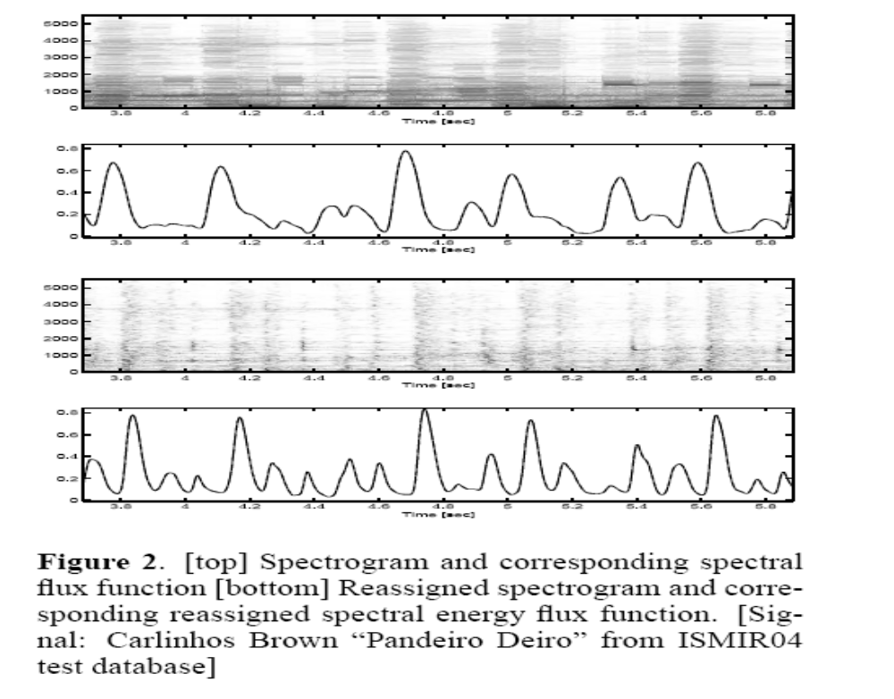
Reassigned Spectral Energy Flux (cont.)

Slide 10
Tempo Detection
The algorithm we propose works in two stages:
- the first estimates the dominant periodicities around a specific time
- the second estimates the tempo and meter/beat subdivision paths that best
explain the observed periodicities along time.

Slide 11
Periodicity Estimation
Periodicity estimation: combined DFT and Frequency Mapped ACF
DFT: We note F(w_{k}, t_{i}) the amplitude spectrum of e(n) for a frequency w_{k} and
a frame centered around time t_{i}
Frequency Mapped ACF (FM-ACF): We note A(l, t_{i}) the
normalized (in energy and in maximum value) Auto-Correlation
Function of e(n) for a lag l and a frame centered around time t_{i}.
A(w_{k}, t_{i})

Slide 12
Periodicity Estimation (cont.)
Combined function: We now have two measures (the DFT and the FM-ACF)
of periodicity at the same frequencies w_{k}.
We finally compute a combined function Y(w_{k}, t_{i}) by multiplying the DFT and
the FM-ACF at each frequency w_{k}: Y(w_{k}, t_{i}) = F(w_{k}, t_{i}) · A(w_{k}, t_{i})

Slide 13
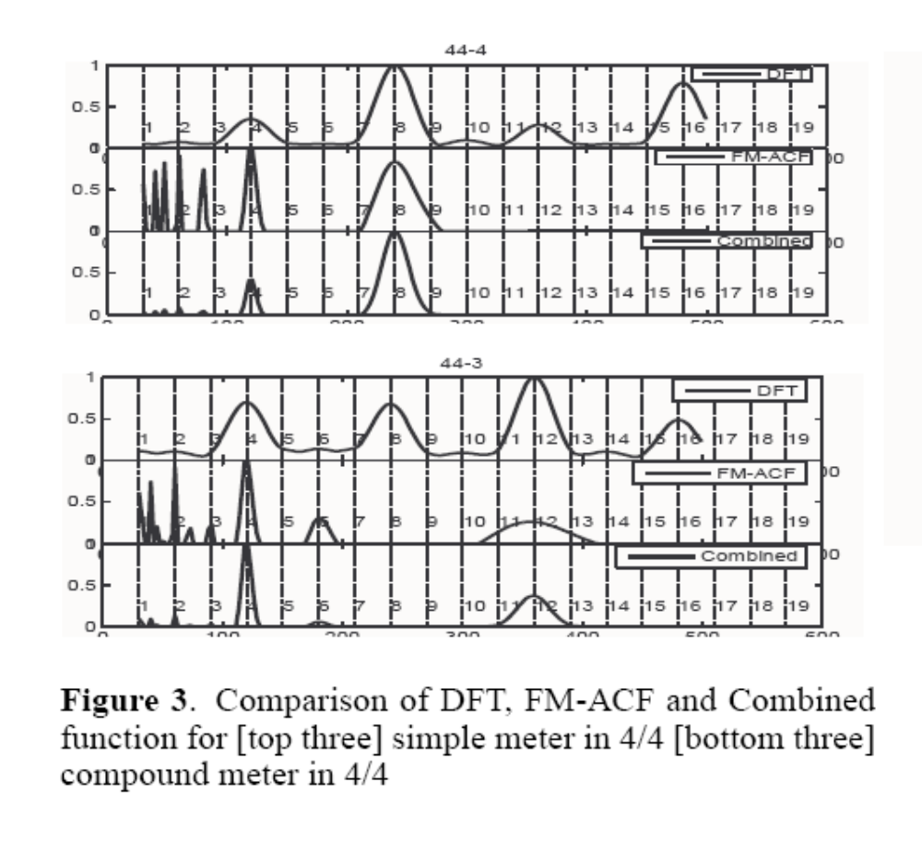
Periodicity Estimation (cont.)
Combining both functions allows keeping only the common frequencies:
In the case of a simple meter [top]
One at the tempo (4) and one at the shortest interval (8).
In the
case of a compound meter [bottom],
one at the tempo (4) and one at
the shortest interval (12).
a simple meter in 4/4
(each beat is divided into halves)
a compound meter in4/4
(each beat is divided into thirds)

Slide 14
Tempo Estimation
Tempo estimation: Viterbi decoding of “tempo states”
We estimate the dominant periodicities Y(w_{k}, t_{i}) at each time t_{i} . We then look
for the temporal path of tempo that best explains the observed periodicities
over time.
We consider three different meter/beat subdivision templates (mbst):
the duple/ simple (noted (2-2)),
the duple/compound ((2-3), example is 6/8 meter)
and the triple/ simple ((3-2), example is 3/4 meter).

Slide 15

Tempo Estimation (cont.)
We define a “tempo state” as a specific combination of a tempo frequency b_{i} and a mbst m_{j} : S(i, j) = [b_{i} , m_{j} ] with i I the set of considered tempo and j {1, 2, 3} the three considered mbst.
We look for the most likely temporal succession of “tempo state” given our
observation. We formulate this problem as a Viterbi decoding algorithm
Viterbi Algorithm - Finding most probable sequence of hidden states

Slide 16
HMM
隱藏式馬可夫模型 - 每個音框的特徵參數向量視為一個符號（symbol），因為一段語音必然含有一個以上的音框，因此語音就可被視為一連串符號的集合。在隱藏式馬可夫模型裡，使用了雙重隨機程序（Doubly Stochastic Process），
一個是狀態轉移機率（State Transition Probability），
另一個則是狀態觀測機率（State Observation Probability），
此方法可解決符號與符號之間的連接方式及符號本身所代表之語音訊號的產生方式。
狀態轉移機率矩陣(State Transition Prob.)，當聲音由一個狀態轉移到下一個狀態需要一個機率來描述狀態的變化情形，我們以狀態轉移機率矩陣來描述狀態改變的機率分佈。
狀態觀測機率(State Observation Prob.)，這個參數是聲音的觀測
符號在某一個狀態的機率值，由於每個聲音的特徵值音框在不同的狀態會有不同的機率值，這個機率值會影響到聲音在某個狀態上停留或變化的時間。

Slide 17
Viterbi Decoding Algorithm
解決了計算隱藏式馬可夫模型產生觀測序列的機率值問題，還需找出觀測序列符號之最佳狀態序列，維特比演算法可用來找出最佳狀態序列。維特比演算法使用動態規化的技術，只考慮前一級最佳狀態並沿途記錄累積路徑之最大可能機率值，可大量節省計算時間。
For a particular HMM, the Viterbi algorithm is used to find the most probable sequence of hidden states given a sequence of observed states.

Slide 18
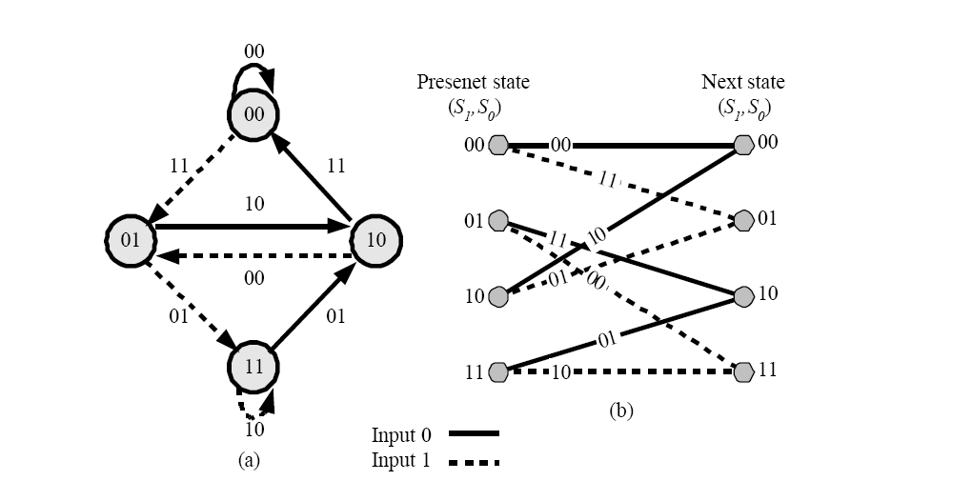
Viterbi Decoding Algorithm (cont.)

Slide 19
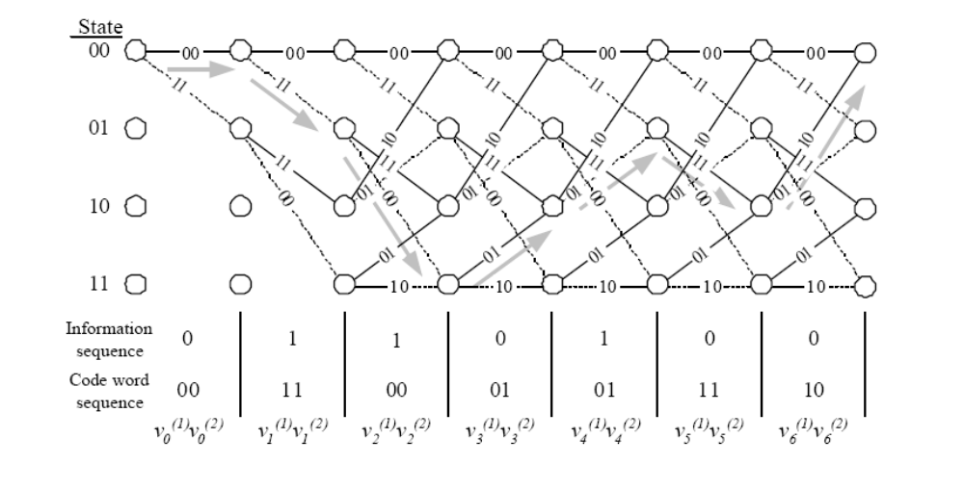
Viterbi Decoding Algorithm (cont.)

Slide 20
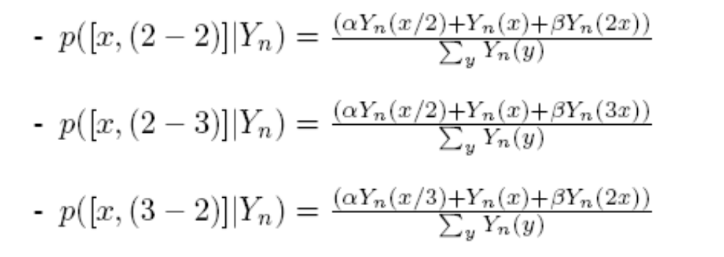
Tempo Estimation (cont.)
Observation probability: p_{obs}(b_{i} ,m_{j}) = p_{prior} (b_{i} , m_{j})· p([b_{i} , m_{j} ]| Y(w_{k}, t_{i}) ).
p_{prior} (b_{i} , m_{j}) - the prior probability to observe a specific bpm i and a specific mbst j.
p([b_{i} , m_{j} ]| Y(w_{k}, t_{i}) ) - the probability to observe a specific tempo i and mbst j given our observations Yn(x).
This probability is computed using the following equations
(we set α = β empirically to 0.5):

Slide 21
Tempo Estimation (cont.)
Transition probability:
    p_{trans} ([b_{i} , m_{j} ][b_{k} , m_{l}]) =p_{trans}([b_{i}] , [b_{k}]) · p_{trans}([m_{j} ] , [m_{l}])
    Finally a standard Viterbi decoding algorithm gives us the
    best path along time through the states [b_{i} ,m_{j} ] therefore
    gives us simultaneously the best tempo and the best mbst
    that explain Y_{n}(w_{k}, t_{i}).

Slide 22
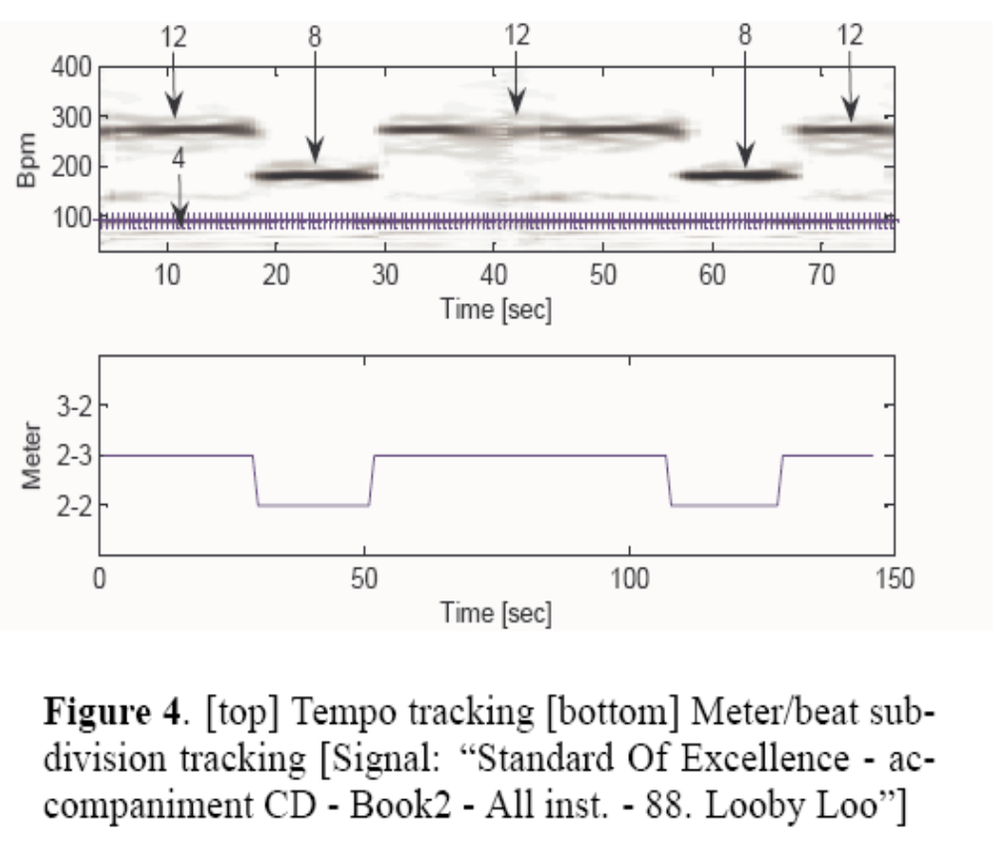
Tempo Estimation (cont.)
The top of the figure represents the estimated tempo track along time
(+) superimposed to the periodicity observation Yn(w_{k}, t_{i})
The bottom part represents the estimated mbst along time.
The tempo remains constant during all the track duration but depending on the local periodicities (4-12 or 4-8), the
mbst is estimated as either (2-3) or (2-2). The tempo and mbst estimations are correct.

Slide 23
Evaluation
The proposed algorithm was evaluated on three databases:
- the “ballroom-dancer” database (698 tracks of 30 s. long) used for the ISMIR2004 “tempo induction contest”
- the RWC database which contains many examples of interesting music
genre for tempo recognition (like classical and jazz music) , from which we
have extracted the segment from 30 s. to 50 s and annotated it by hand.
- a private database consisting mainly of pop-rock ’hits’ (158 extracts of 20 s. long).

Slide 24
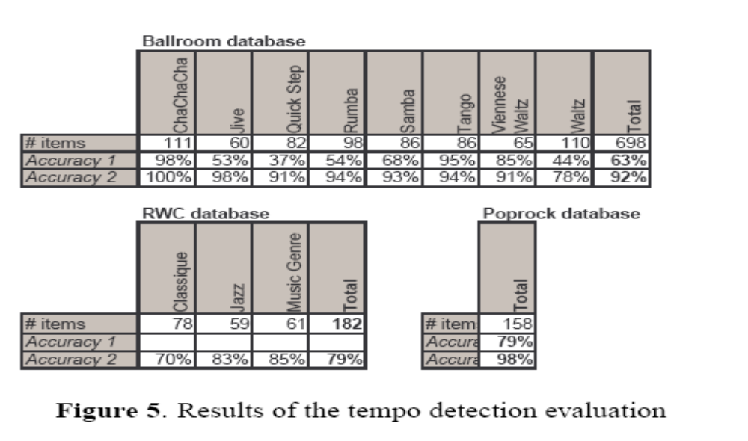
Evaluation (cont.)

Slide 25
ADAPTATION TO MIREX 2005 PERCEPTUAL TEMPO INDUCTION
http://www.music-ir.org/evaluation/mirex-results/audio-tempo/index.html
Remark that our algorithm was not designed to output two tempi; B is just the
second most likely “tempo state” without any dependence on the previous
choice of A; therefore B can have a different meter/beat subdivision.
-TIME VARIABLE TEMPO DETECTION AND BEAT MARKING

